Slide 1


Term:
AUTUMN
CORE
Area:
Marketing
Title:
Introduction to Management
Instructor:
Prof Mayank Pareek

Slide 2
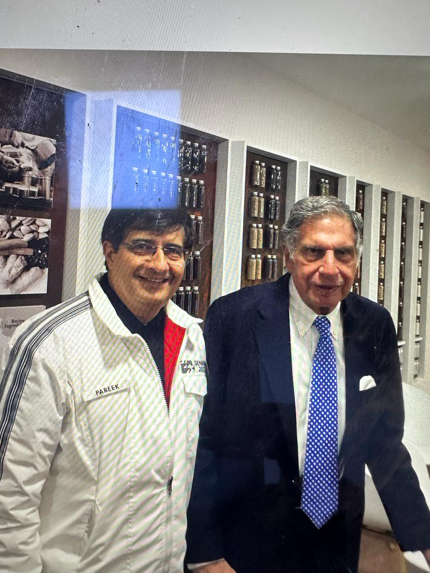
1to Faculty Introduction :
Professor of Practice since May 2021
4 decades of Corporate and Business experience
MD & CEO Tata Motors, till Mar 2021
Chairman TMETC, Concorde, Chairman TMLD, Chairman TMIBL
ED MSIL
Awards : ET : Young Marketeer of the year; CII: Manager of the year; CNBC : among 100 most powerful persons in India
40 Under 40
Core Competence : Brand Building and Business Turnaround
Academics : B. Tech : IIT BHU Varanasi;
MBA : IIM Bangalore

Slide 3
Three Blessings
1. INDIAN
GDP : USD 3900 Billion
Largest Growing Economy
3rd Largest 4 Wheeler and Largest 2 wheeler Market
2nd Largest Smart Phone Market; Exporting USD 8 Billion Smart Phones
2nd Largest number of Start-up in world
USA: 71000; India:13100; UK:6200
Healthy Sectoral Composition of Economy : Service : 54%; Industry : 26%; Agriculture:20%

Slide 4
Three Blessings
2. YOUNG
Major economies of the world are ageing
Demographic Dividends : India : 28.7, Japan : 48.6 , Germany : 47.8 : USA: 38.5; China : 38.4
3. Studying at the premier institute of India
1289 companies, including 18 unicorn
Salil Parekh, Bhavish Agarwal, Nandan Nilekeni, Kanwal Rekhi, Parag Agarwal ………

Slide 5
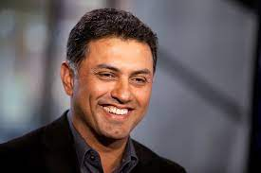
Nikesh Arora
On 4th Jan 24 : 1st Indian Non Founder Tech Billionaire
B.Tech : IIT BHU
MBA : Northeastern University Boston
Power of Management Education

Slide 6
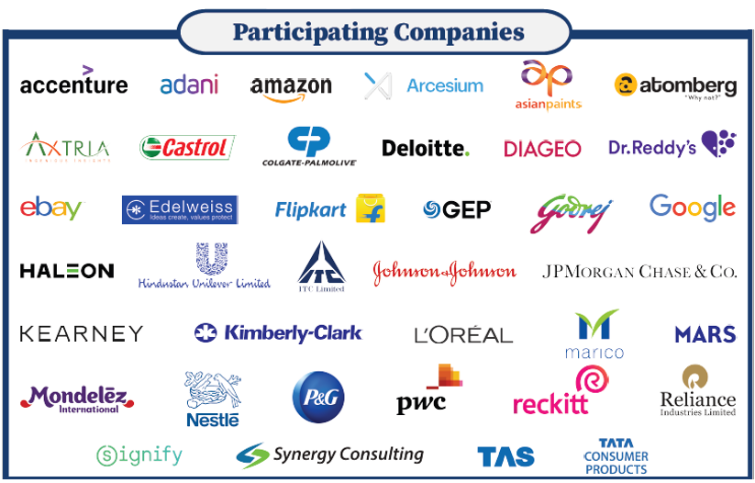
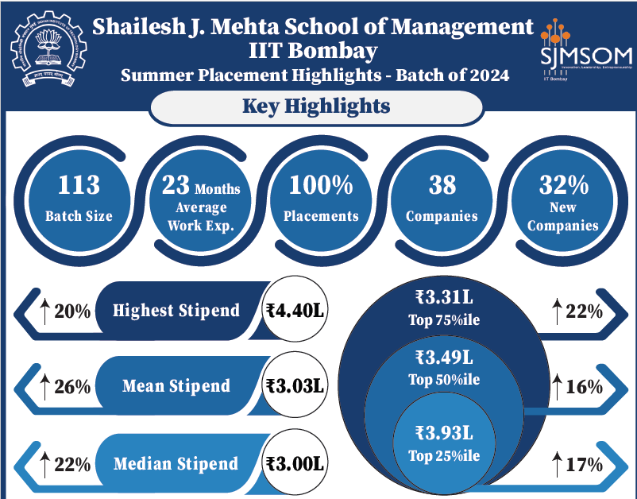
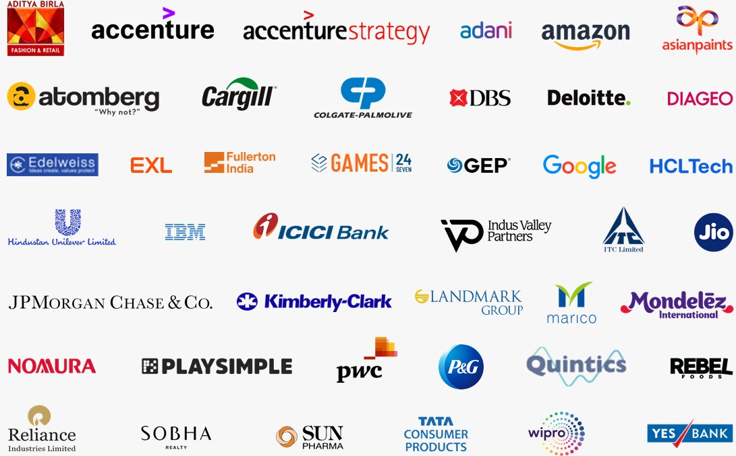
MBA Final Placement Highlights – Placement Drive conducted in Nov/Dec for 2nd year students of SJMSOM, IIT Bombay
Final Placement Highlights – Batch of 2023
115
19 Months Average Work Ex.
44
34%
10%
Highest CTC
₹ 54.0 L
₹ 29.15 L
3%
Top 75%ile
₹31.72 L
5%
Average CTC
₹ 27.3 L
Top 50%ile
2%
₹35.76L
1%
Median CTC
₹ 26.0 L
Top 25%ile
1%

Slide 7
Learning Objectives :
To understand the role of managers in success of business enterprise
To understand the concept and basics of managerial science
To understand the principles of management, managerial skills and strategies required to run a business
Role of Ethics and social responsibilities
Develop an understanding of current management issues and develop ability to do preliminary diagnosis there to.
To understand the important of softer skills key to manage business.
Life Hacks to succeed

Slide 8
EVALUATION
S.No | Evaluation Parameter | Contribution
1 | Project Work | 20%
2 | Quiz(s) | 20%
3 | End Term Exam | 50%
4 | Class Participation | 10%
Total |  | 100%
80% Attendance is mandatory as per Institute Policy

Slide 9
Quiz: 20 Marks
Objectives : Asses your conceptual understanding
Three Quizzes
Best two out of three will be considered for final assessment
Lunch with Top ten students in each quiz
Award for student(s) who stand among top ten in all three quizzes

Slide 10
Project : 20 Marks
Objectives : Sensitize you about how a real company works
Demonstrate leadership and followership skills
Learn communication and organising skills
Learn team working
Groups of 10 students
Study a company allotted to you
Leader & Co leader : Ensure participation, timely presentation, 10 Marks
Presentation 10-15 minutes on a particular aspect of business

Slide 11
End Term Exam : 50 marks
Objectives : Application of concepts into real business
Mix of Multiple business cases; analysis of business news
Class Participation : 10 marks
Objective : Opportunity for all to participate and express
Develop Public speaking skills

Slide 12
3E Learning
Engage
Energise
Entertain
Learn while having fun

Slide 13


Slide 14
King Fisher Airlines
Indigo Airlines
Founded (Year) | 2003 | 2006
Revenue | USD 1 Billion | USD 10 Billion
Market Cap | **** (closed) | USD 23.5 Billion

Slide 15
Blackberry
Apple
Founded (Year) | 1984 | 1976
Revenue | USD19 Billion (2011) | USD 395 Billion
Profit | USD 2.5 Billion | USD 100 Billion
Market Cap Peak | USD 80 Billion | USD 3900 Billion

Slide 16
HDFC Bank
Yes Bank
Founded (Year) | 1994 | 2004 (2015)
Revenue | USD 21 Billion | USD 2.8 Billion
Profit | USD 4.6 Billion | USD (2.8 BN)
Market Cap | USD 124 Billion | USD 1.5 Billion

Slide 17
AMAZON
WALMART
Founded (Year) | 1994 | 1962
Revenue | USD 469 Billion | USD 600 Billion
Profit | USD 33 Billion | USD 146 Billion
Market Cap | USD 860 Billion | USD 388 Billion

Slide 18
Toyota
Tesla
Founded (Year) | 1937 | 1962
Revenue | USD 314 Billion | USD 92 Billion
Profit | USD 42 Billion | USD 6 Billion
Market Cap | USD 299 Billion | USD 1020 Billion

Slide 19
Google
Yahoo
Founded (Year) | 1998 | 1994
Revenue | USD 182 Billion | USD 7 Billion
Profit | USD 49 Billion | Loss
Market Cap | USD 1200 Billion | Acquired by Apollo Investments

Slide 20
Companies founded almost in the same economic environment
Companies operated in similar industries
But Yet Some Failed and Some Succeeded
Vision. Not Customer Centric. Changing With Time. Technology. Business Model. Governance. Brand. Operations. Quality. Markets. Finance. Leverage. Legal. Human Resource. R&D
MANAGEMENT

Slide 21
What is the purpose of business
To make profit
In a legitimate way
On a long-term sustainable basis

Slide 22
What is the purpose of Management
To make sure that the Business works towards realising its
Vision
Mission
Retaining its Core values

Slide 23
Power of Stock Markets
Sensex in 2005 : 7000
Sensex yesterday : 80000
Rs 10 Lacs invested in 2005 would be Rs 114 Lac today
If you had invested Rs 10 Lacs in Equity Shares of MSIL : Rs 1000 Lacs

Slide 24
Power of Compounding
Your First Year Salary : Rs 25 Lacs
Invest for 20 Year @ 10%
Rs : 2 Crore

Slide 25
Thank You

